Slide 1
OCT correlations with new data
Adam Shah

Slide 2
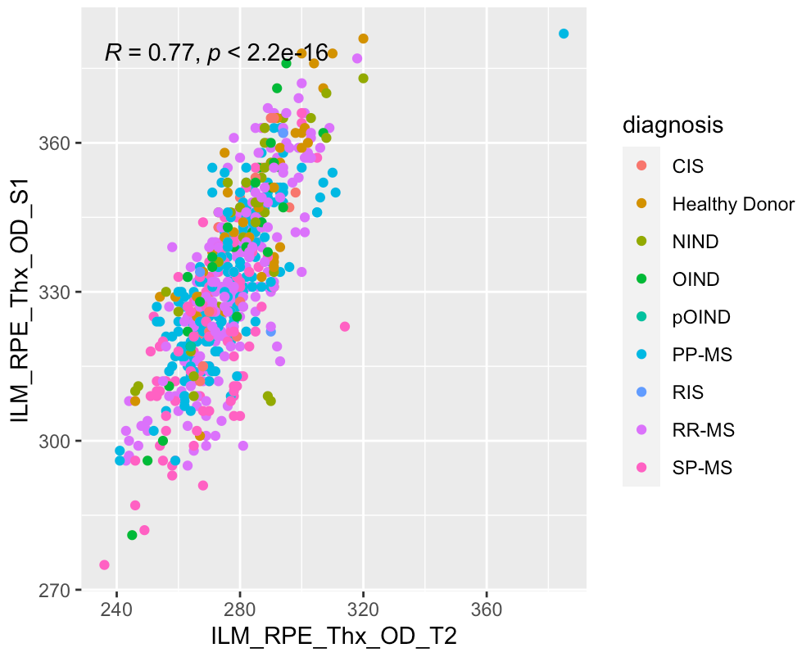
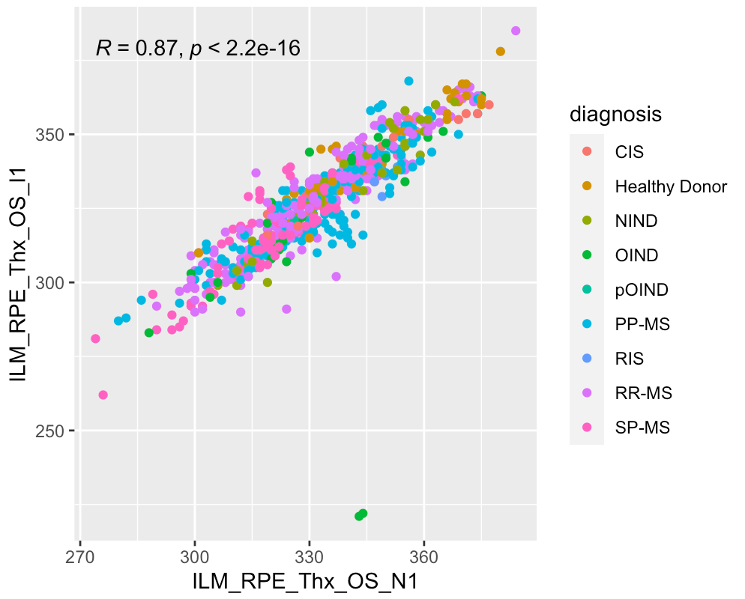
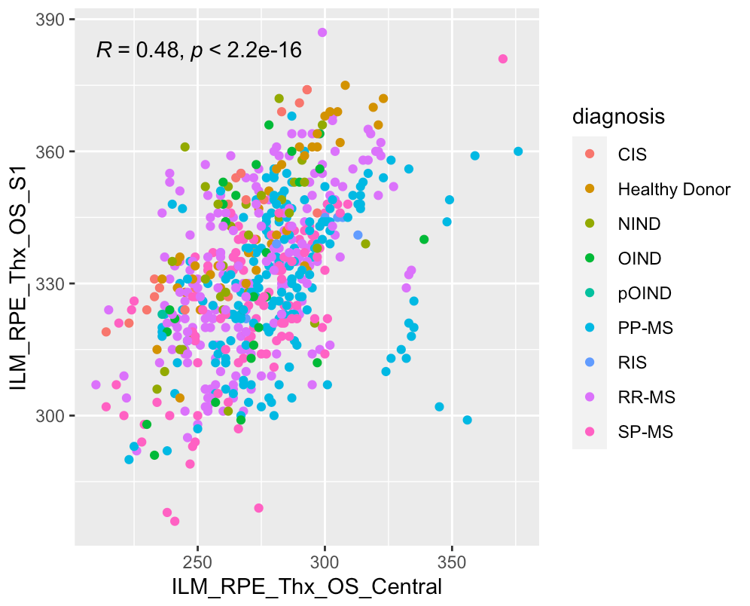
Full dataset (same eye)
*greater correlation between regions the same distance from central fovea,
lesser correlation between the center and other regions

Slide 3
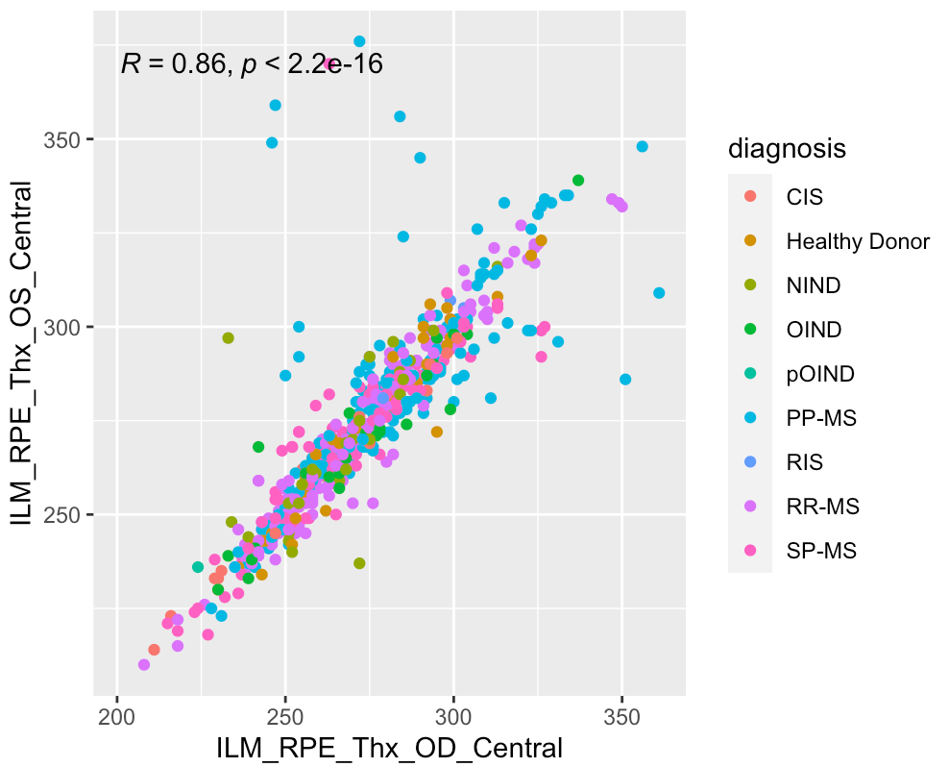
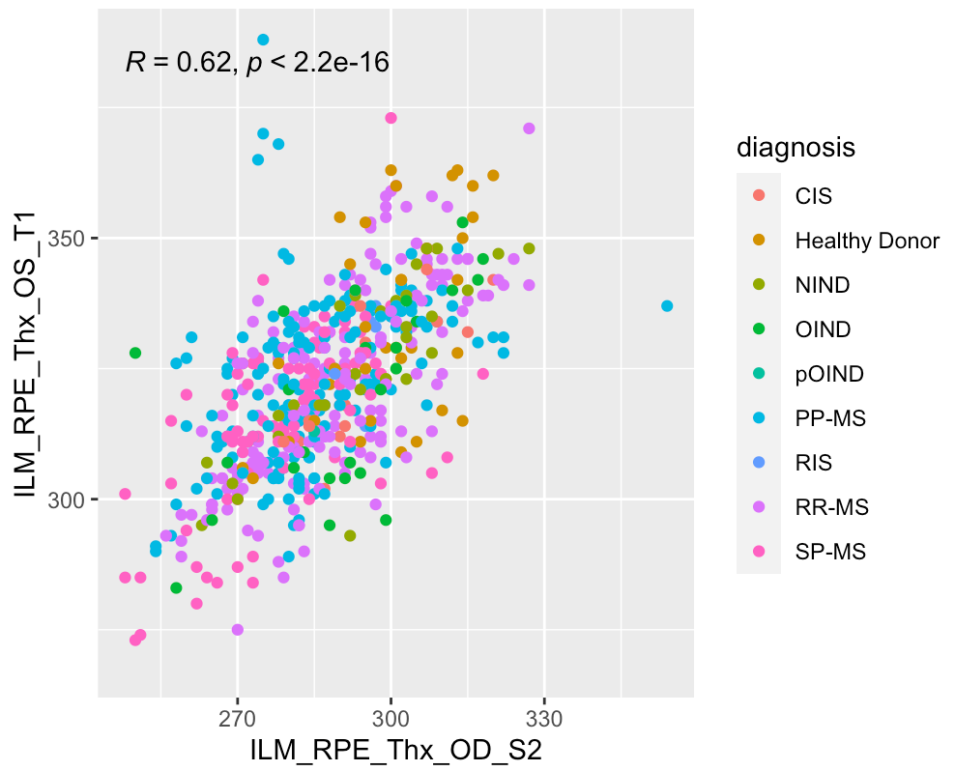
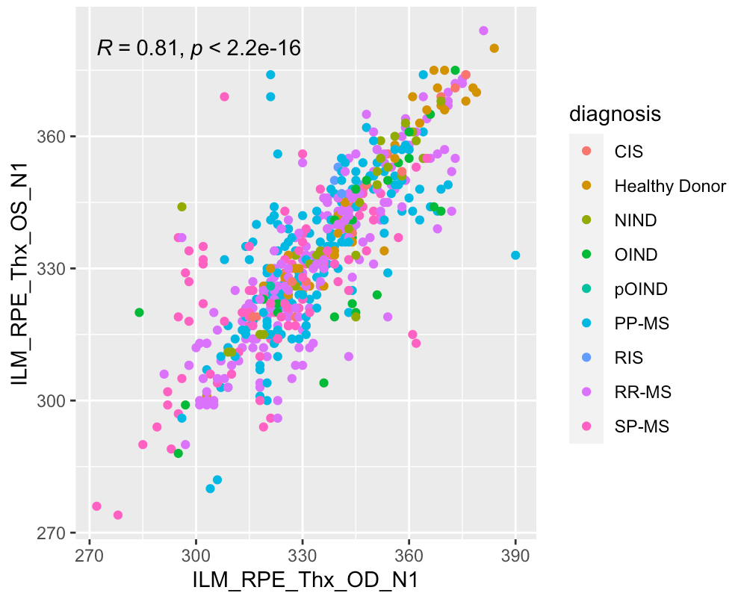
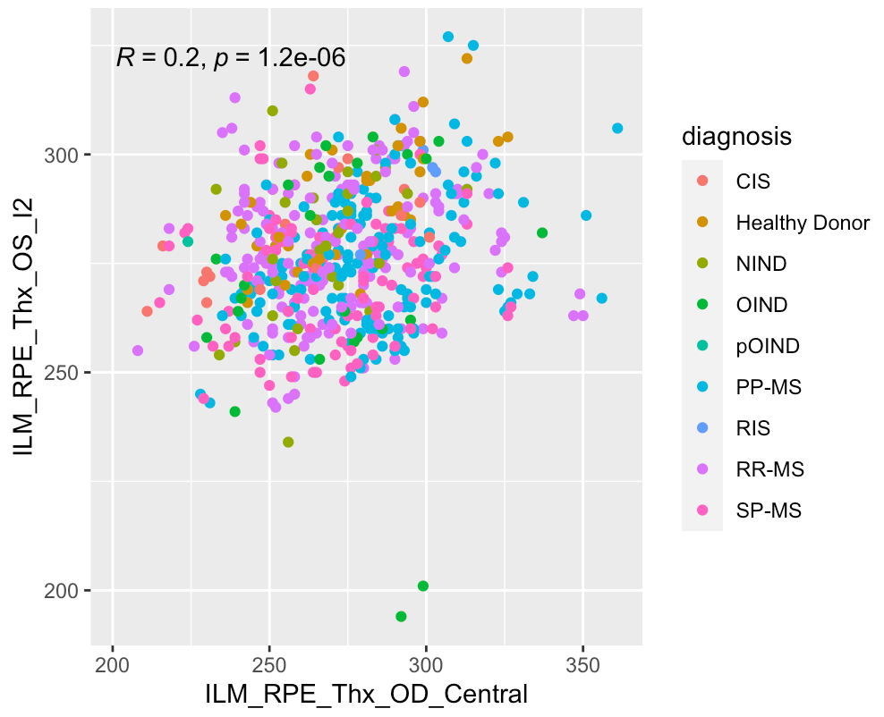
Full dataset (across eyes)

Slide 4
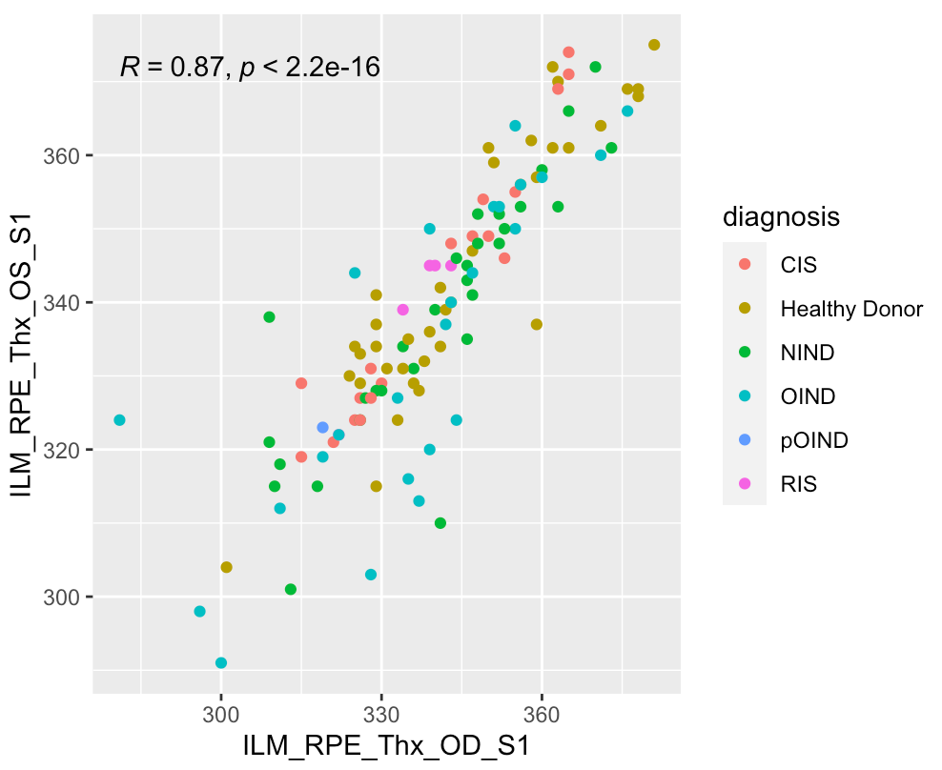
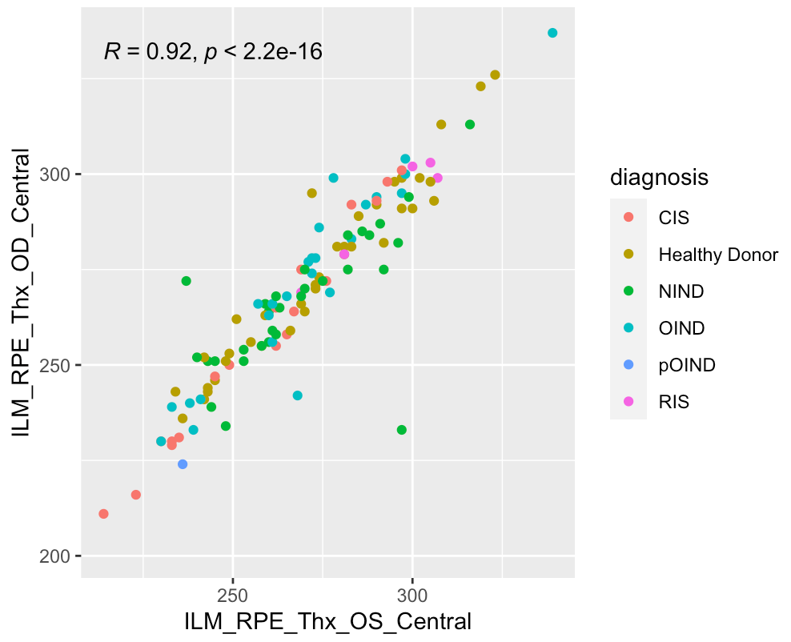
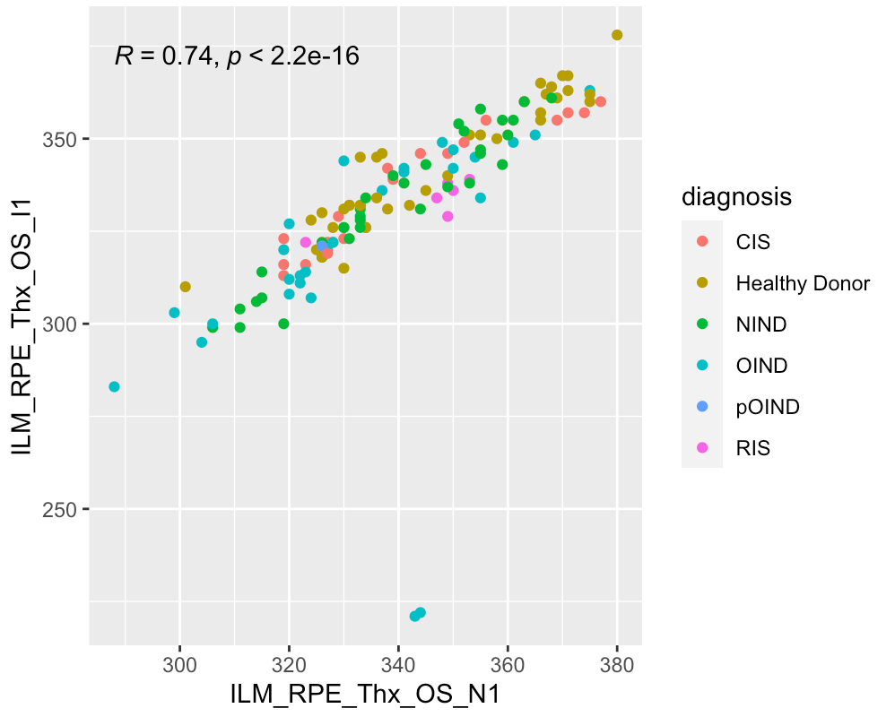
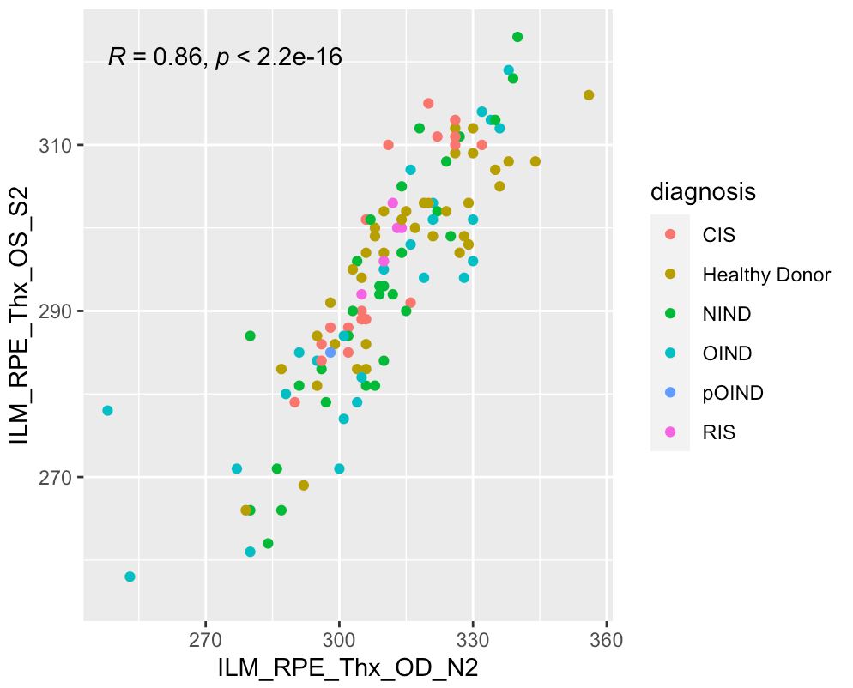
Non-MS cohort

Slide 5
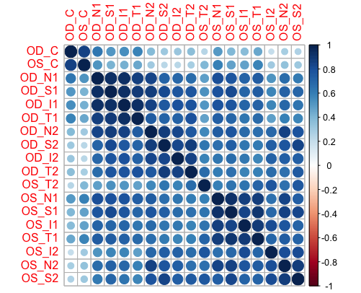
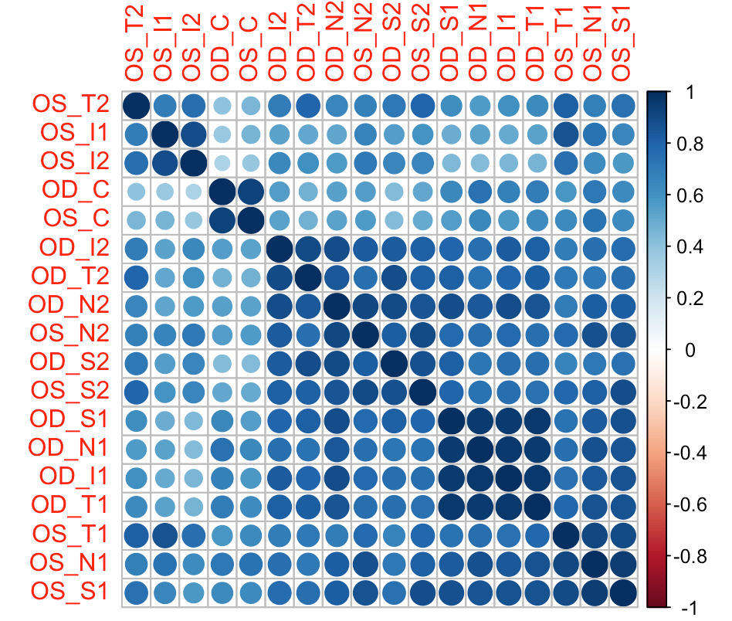
Correlation tables (hierarchical clustering)
Full dataset (n=640)
Non-MS cohort (n=130)
*full dataset shows clustering by each eye outside of the center, non-MS cohort shows
less clear results but still shows some grouping by eye and distance from fovea

Slide 6
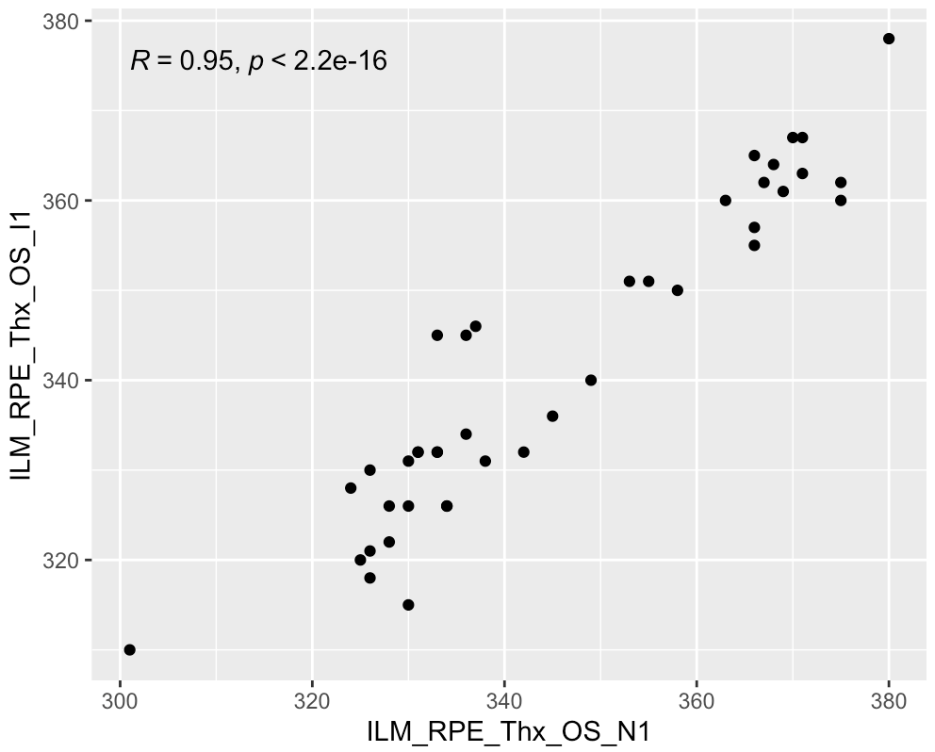
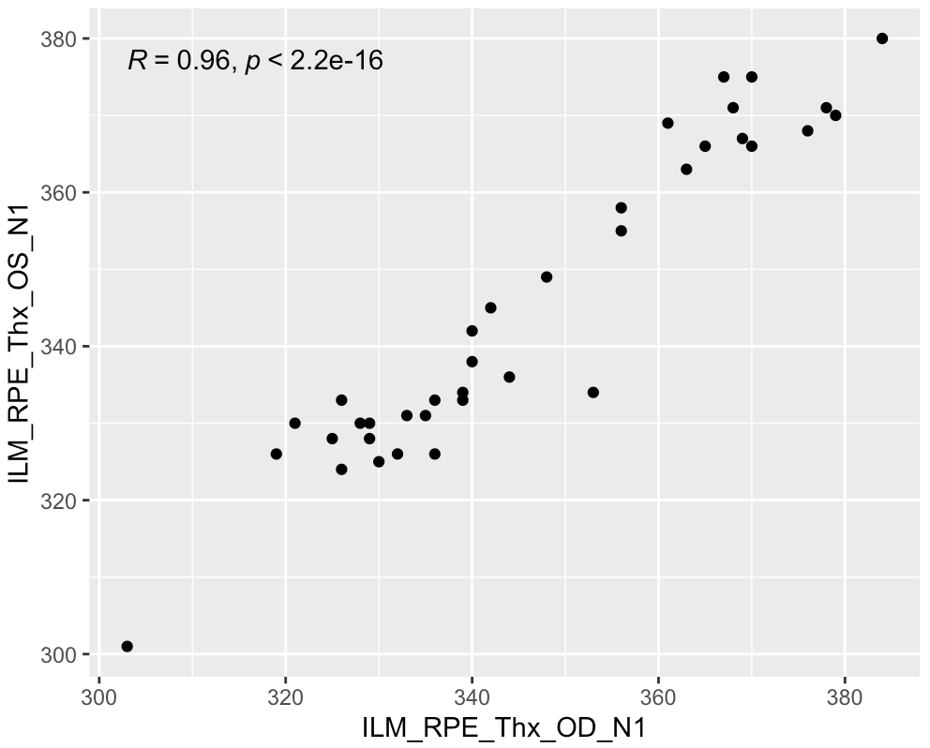
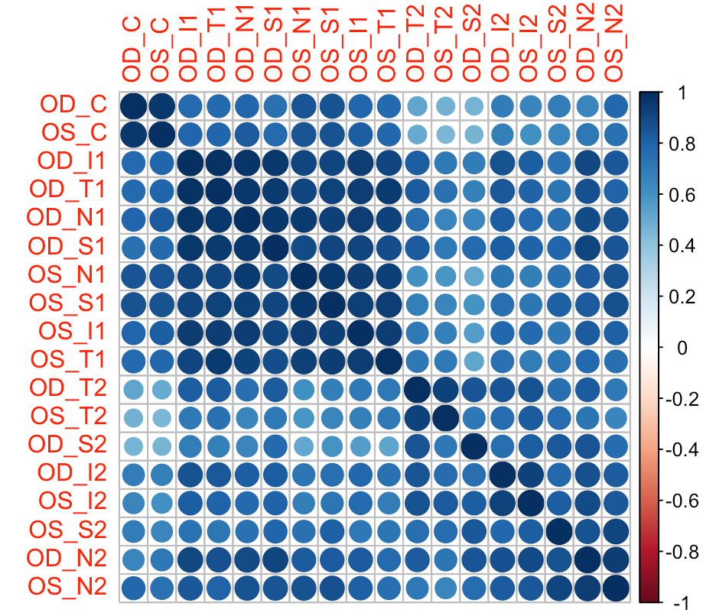
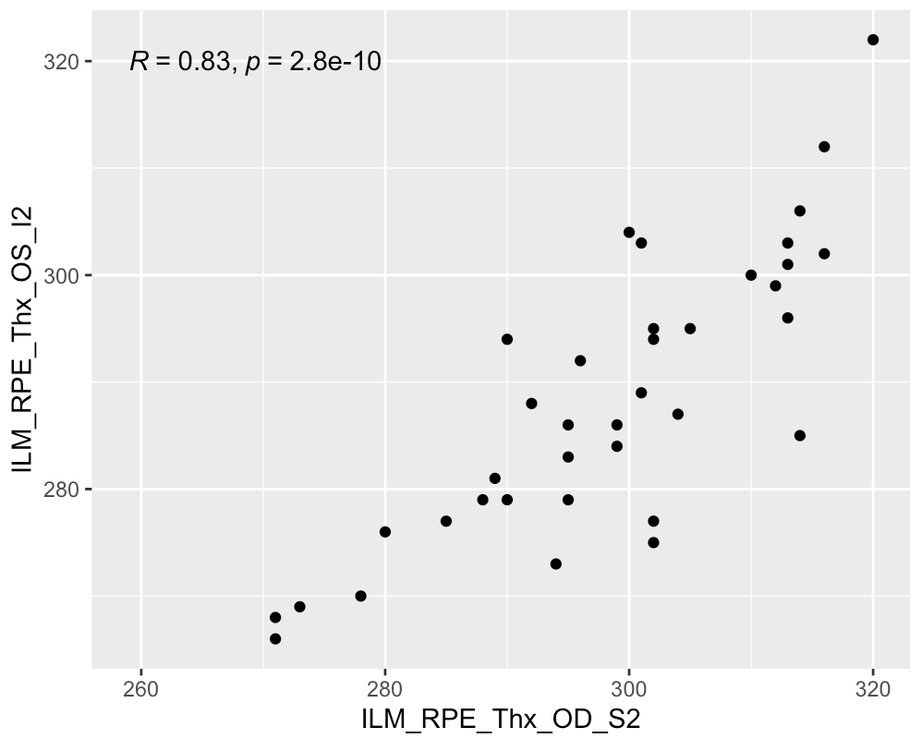
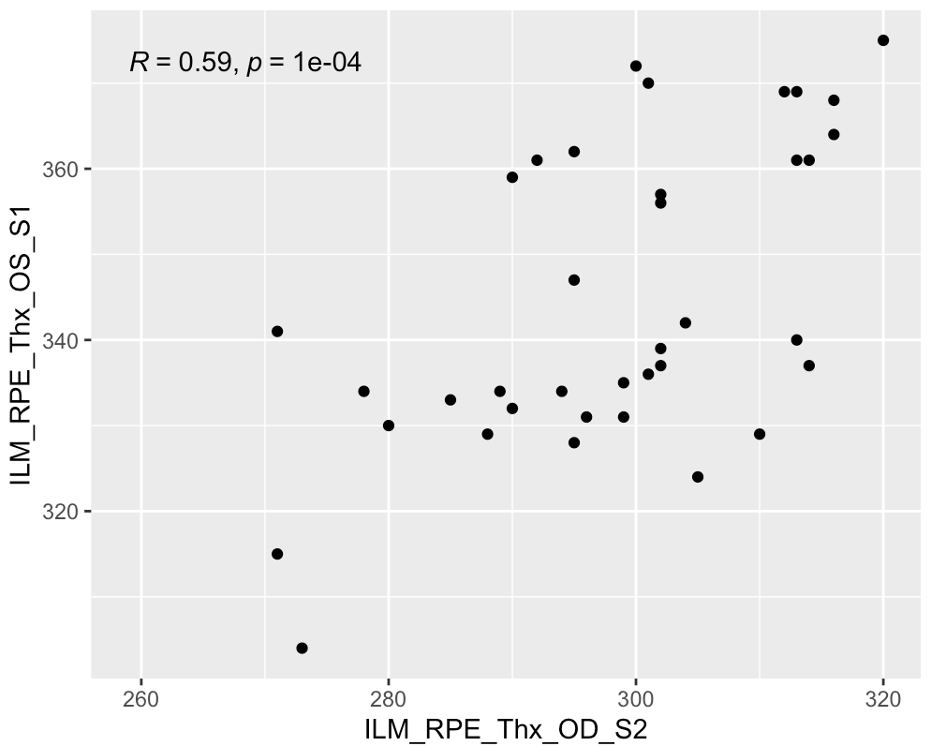
What about just healthy donors?
The non-MS cohort correlation table looked a bit strange, so I wondered if it was because
a lot of the patients in this cohort are not exactly “healthy”.
Healthy donors (n=41)
*healthy donors shows clustering by
distance from fovea across eyes

